Slide 1
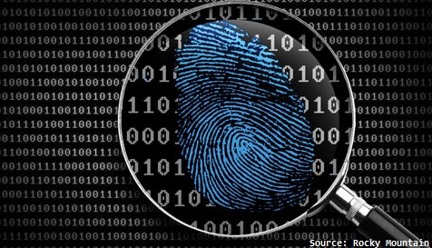
CS483 Digital Forensics

Slide 2
Course Objective
This course will introduce students the concepts underlying Digital Forensics, current techniques used in the identification of malicious or unwanted behavior on computer systems and lay the foundation for future work in the analysis of malicious software.

Slide 3
Course Learning Objectives
Apply a scientific methodology to the acquisition and analysis of digital evidence.
Use multiple software tools to acquire and analyze digital evidence.
Explain digital forensics concepts, results, and conclusions to technical and non-technical audiences.
Demonstrate an understanding of the process and tools required to reverse engineer malware.
Perform memory forensics to hunt for adversary and criminal activity.

Slide 4
Course Topics
Foundational Forensics Concepts
File System Forensics
Windows Internals
Reverse Engineering and Binary Analysis
Malware Forensics and Malware Analysis
Memory Forensics

Slide 5
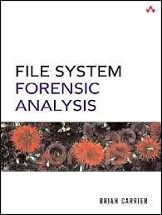
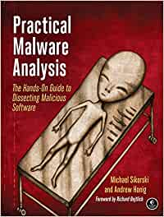
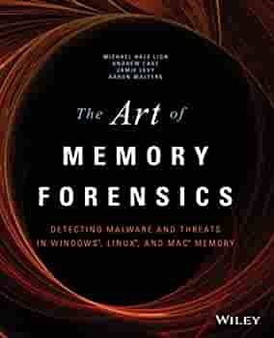
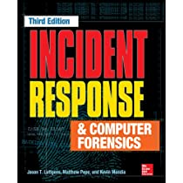
Texts
Practical Malware Analysis, by Michael Sikorski and Andrew Honig
The Art of Memory Forensics: Detecting Malware and Threats in Windows, Linux, and Mac Memory, by Aaron Walters, Jamie Levy, Andrew Case and Michael Hale Ligh
File System Forensic Analysis, by Brian Carrier
Optional: Incident Response & Computer Forensics, Third Edition, by Jason Luttgens, Matthew Pepe and Kevin Mandia

Slide 6
Textbook Access
Access to all four texts is free via learning.oreilly.com.
Create an account using your army.mil email for complete access.
Access to Practical Malware Analysis and The Art of Memory Forensics is also available via westpoint.edu/library.

Slide 7
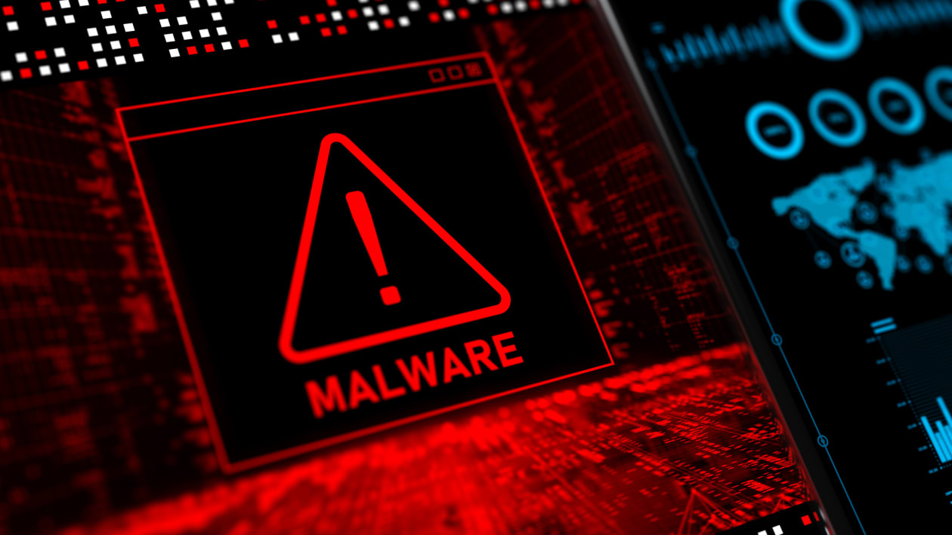
Course Admin
Canvas is primary LMS
Teams
If we go to remote operations, class will be on Teams
We use EECSnet extensively
We deal with live malware in this class, exercise caution

Slide 8
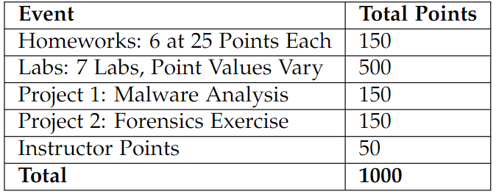
Graded Events

Slide 9
Academic Standards
EECS Policy Memo #10
DPOM 02-10

Slide 10





Instructor
MAJ Adam Duby
Office: TH1111
Lab: TH212 (Cyber Lab)
Cell: 706-339-4292
adam.duby@westpoint.edu
10th AAMDC
Patriot
Cyber Protection Brigade Cyber Protection Team
NSA
Malware Analyst
Cyber Protection Brigade BDE Forensics & Threat Analysis Officer
University of Colorado
PhD, Computer Engineering
USMA, EECS
Assistant Professor

Slide 11
Student Introductions
Name
Major
Branch

Slide 12
Foundational Forensics Concepts
Lesson 1 – Forensics Concepts

Slide 13
What is Digital Forensics
Defined (DFRWS 2001):
The use of scientifically derived and proven methods toward the preservation, collection, validation, identification, analysis, interpretation, documentation and presentation of digital evidence derived from digital sources for the purpose of facilitating or furthering the reconstruction of events found to be criminal, or helping to anticipate unauthorized actions shown to be disruptive to planned operations.

Slide 14
Fields of Digital Forensics
Network Forensics
Computer Forensics
Malware Forensics
File System Forensics
Memory Forensics
Software Forensics
Hardware Forensics
Mobile Forensics
Operating System Forensics
…..

Slide 15
Digital Forensics Provides:
Cyber Threat Intelligence (CTI)
Insight to attacker tactics, techniques, and procedure (TTPs)
Indicators of compromise (IOC)
Research on adversary capabilities
Information for defenders and mitigation engineering
Criminal evidence
Expert witness
Our course will focus mostly on attack forensics

Slide 16

Notes:
https://www.nbcnews.com/news/us-news/former-american-airlines-pilot-convicted-kentucky-triple-murder-n1271207

Slide 17
The Daubert Standard
Supreme Court case Daubert v. Merrell Dow Pharmaceuticals Inc., 509 U.S. 579 (1993)
Criteria used to determine the admissibility of expert witness testimony in court
Judge can assess if an expert witness’s scientific testimony is based on scientifically valid reasoning that is properly applied to the facts at issue.
Currently used in federal courts and some state courts
Replaced the Frye standard
More information on Daubert can be found here

Slide 18
The Daubert Factors
Whether the theory or technique in question:
Can be and has been tested
Subjected to peer review and publication
Has known or potential error rates
Existence and maintenance of standards controlling its operations
Has attracted widespread acceptance within a relevant scientific community
In 1999, the Supreme Court further clarified that the Daubert Factors may apply to non-scientific testimony, including engineers and other experts who “are not scientists.”

Slide 19
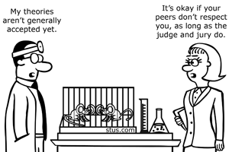
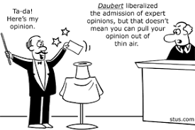
What Does this Mean?
Digital forensic evidence must be rigorously evaluated
Degree of confidence
Do you trust your tools?
Do your peers trust your process?

Slide 20
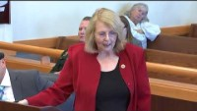
Notes:
Expert Witness: Kevin Stout
Defendant: Mark Sievers
Was found guilty of 1st degree murder of his wife, Teresa Sievers, in Florida

Slide 21
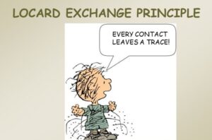
Locard Exchange Principle
The perpetrator of a crime will bring something into the crime scene and/or leave with something from the scene, and both can be used as forensic evidence.
Attacks on information systems:
Log files
Residual malware artifacts
File system artifacts
Memory artifacts

Slide 22
The Observer Effect
The act of observation influences (changes) the forensic evidence
Forensic tools installed on computers alter the system
Volatile memory
Psychological:
Examiner’s bias and subconscious expectations can influence the outcome of a forensic examination

Slide 23
Summary
Digital Forensics
Daubert Standard
Locard Exchange Principle
The Observer Effect

Slide 24
For Next Lesson
Review Course Outline in Canvas
Read Brian Carriar’s Paper
Link Provided in Canvas

